Slide 1

Node.js Basics
The Essential knowledge you need

Slide 2
Module 1
How does the web work
Creating a Node.js Server
Using Node Core Modules
Working with Requests and Responses (The Basics)
Asynchronous Code & The Event Loop

Slide 3

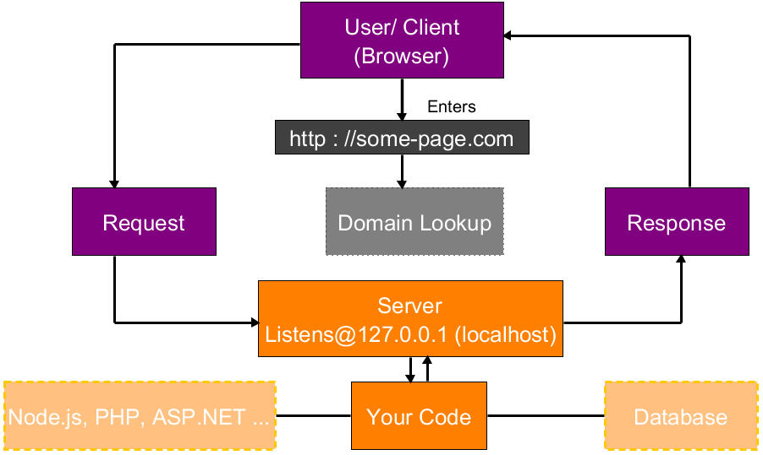



How the web works!

Slide 4
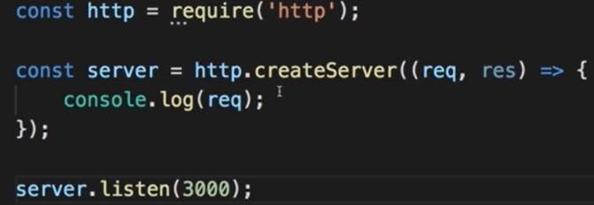
Creating Node.js server
Core Modules
http (Launch a server, sends request)
https (Launch a server with SSL)
fs (Used to read write files)
path (Used to determine absolute paths)
os (Used to read OS level variables)

Slide 5
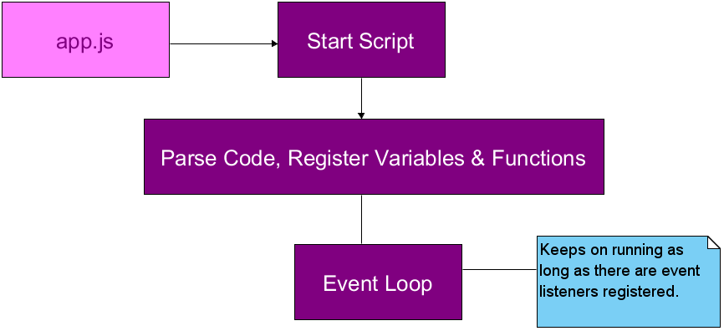
Node.js Program Lifecycle
Use process.exit() to break to event loop

Slide 6
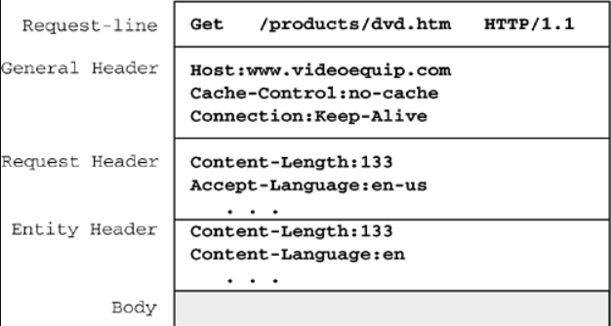
Understanding the request

Slide 7
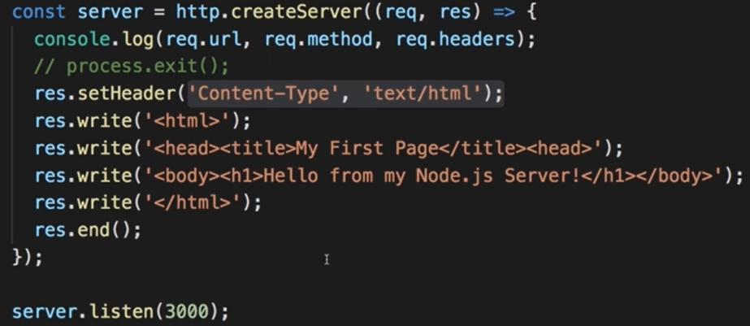
Sending Responses

Slide 8
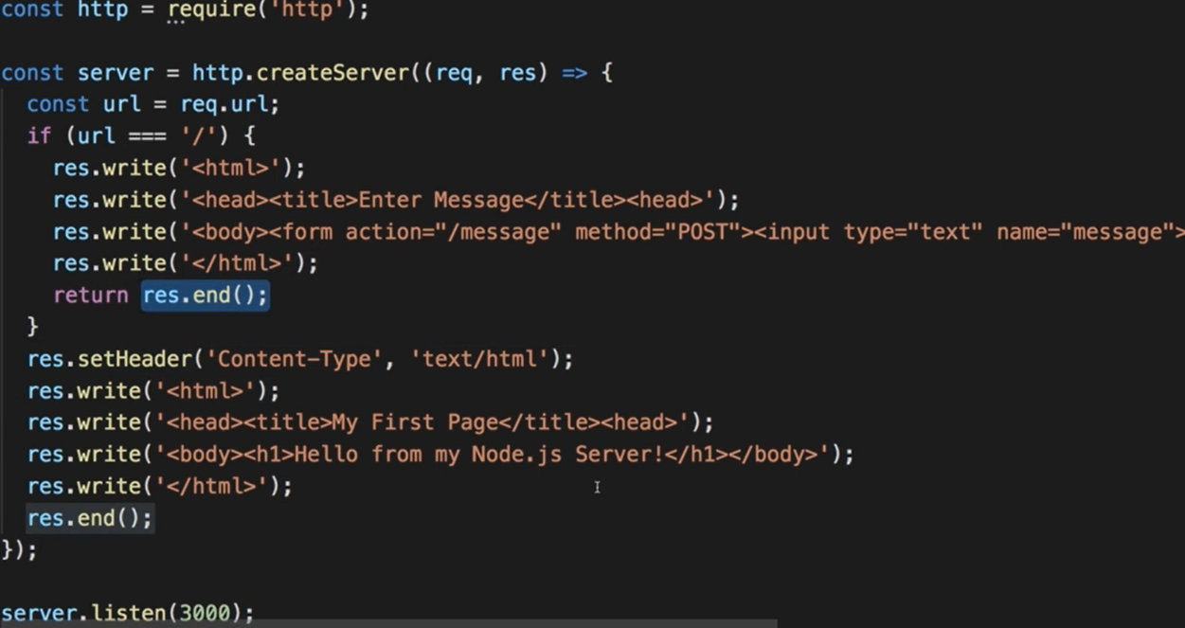
Routing Requests

Slide 9
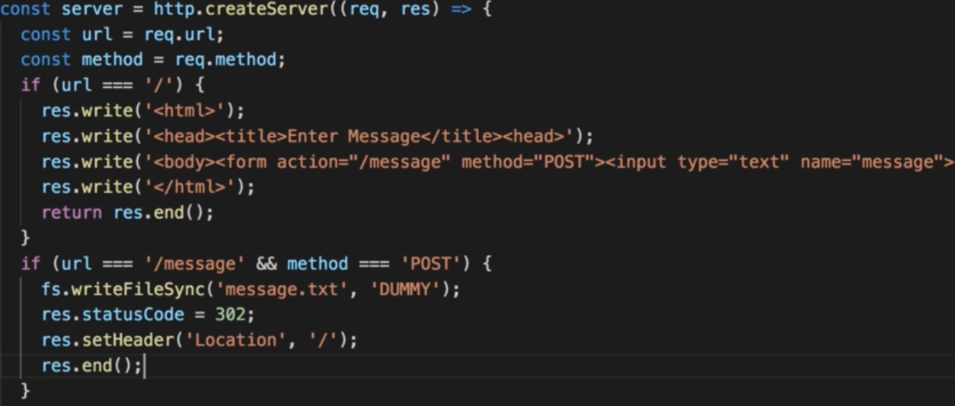
Redirecting Requests

Slide 10
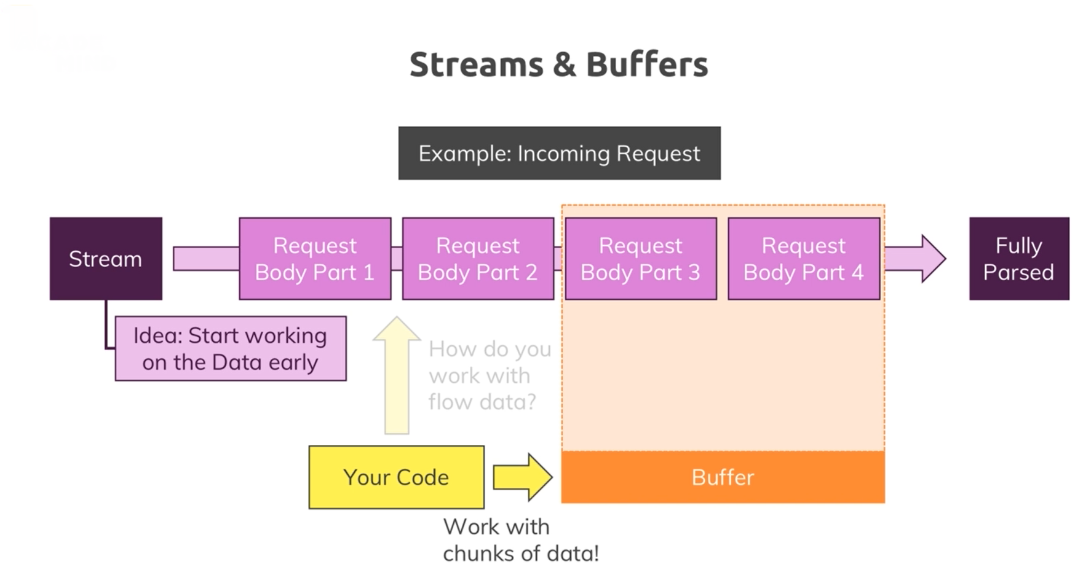
Streams & Buffers

Slide 11
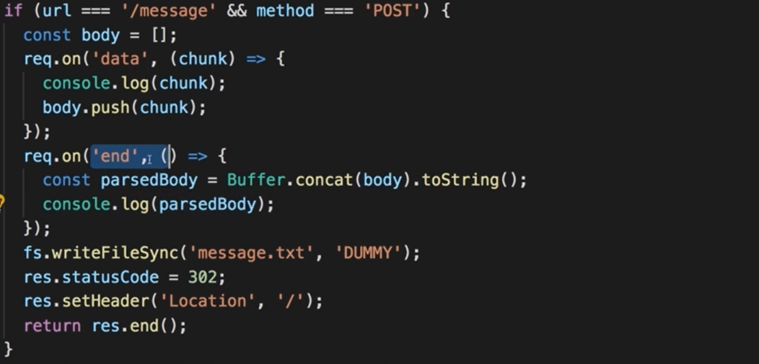
Parsing Request Bodies

Slide 12
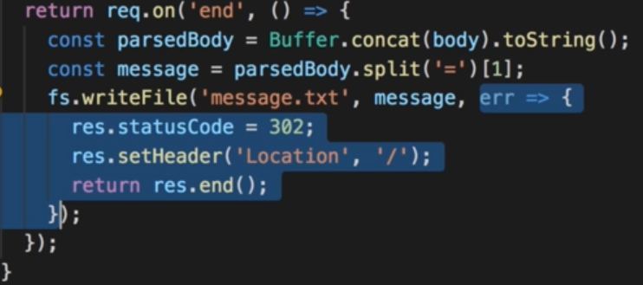
Blocking and Non Blocking Code

Slide 13
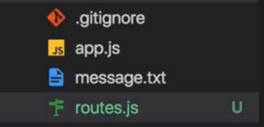
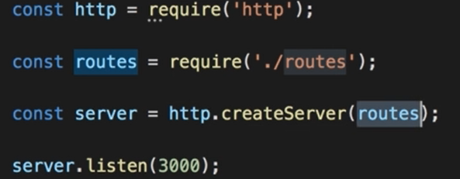
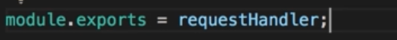
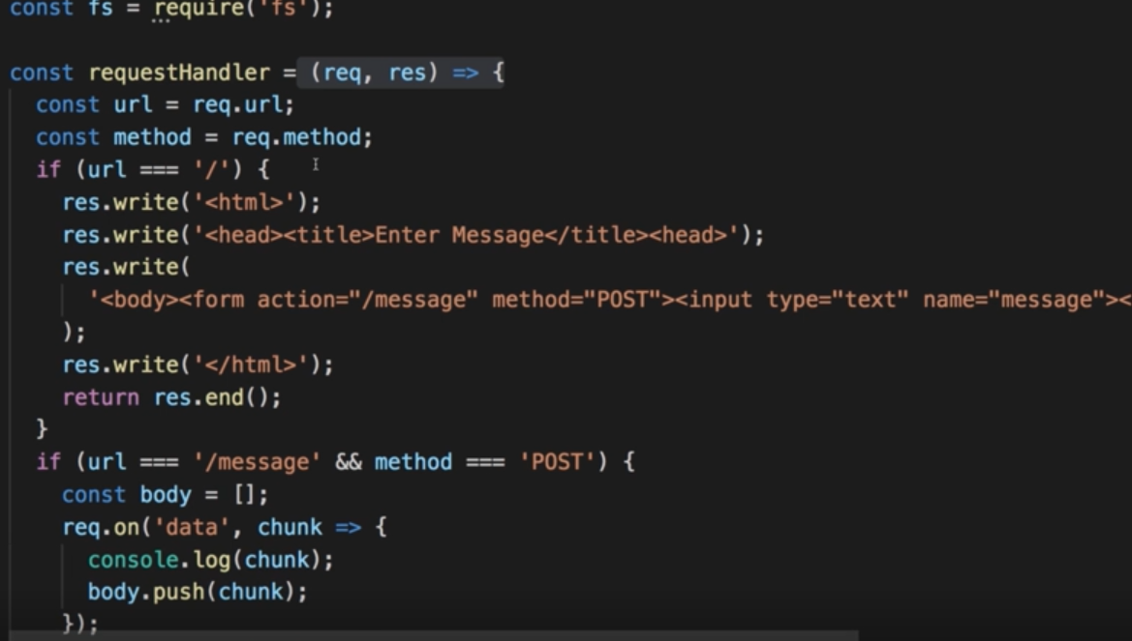
Using the Node Module System

Slide 14

Module 2 – Debugging and Easier Development
Fixing Errors, Developing Efficiently

Slide 15
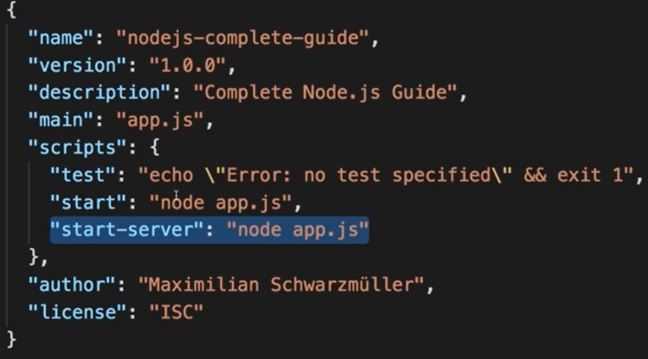
Understanding NPM Scripts

Slide 16
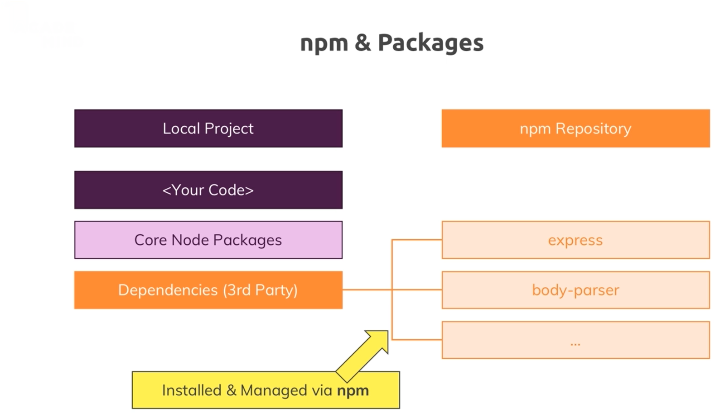
Installing 3rd Party Packages

Slide 17
Installing 3rd Party Packages (Cont.)
You have to restart server each time you made a change in code
Install “nodemon” 3rd party package to alter this behavior
Use “npm install nodemon –save-dev”

Slide 18
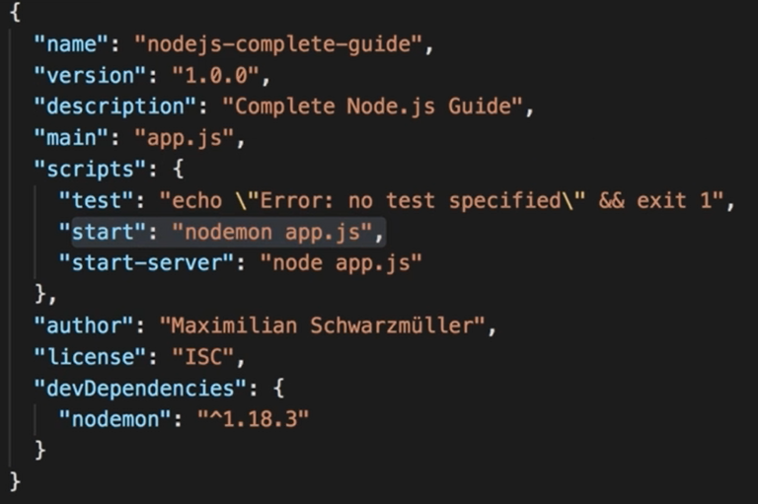
Use Nodemon for Autostarts

Slide 19
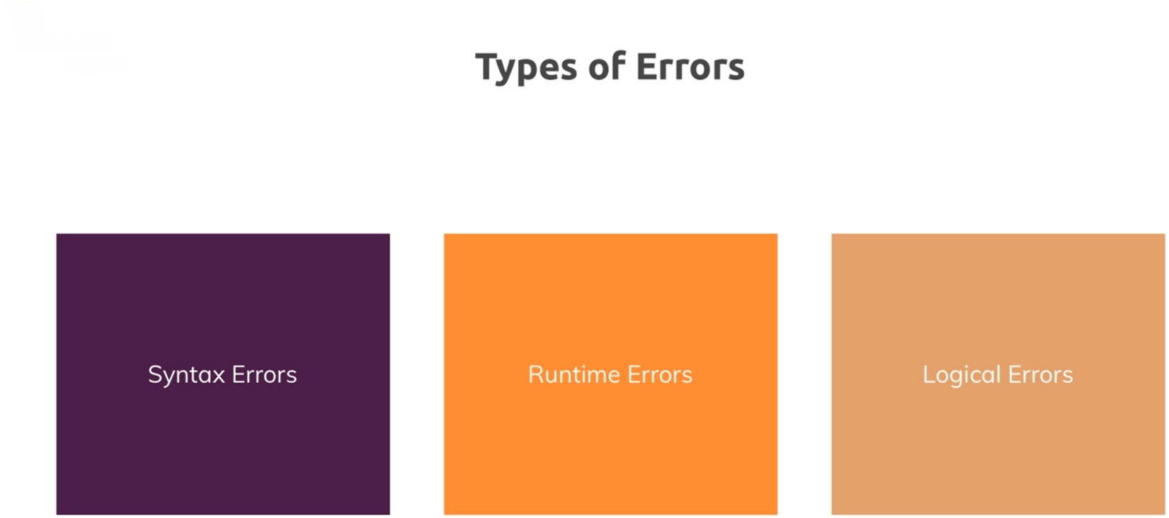
Understanding Different Error Types

Slide 20
Use Debugger
Usually, we use debugger to find logical errors
Start debugger from VS Code
Choose Node.js
Place a break point
Hit the url
Look into code
View Debug Side window
Debug Console

Slide 21
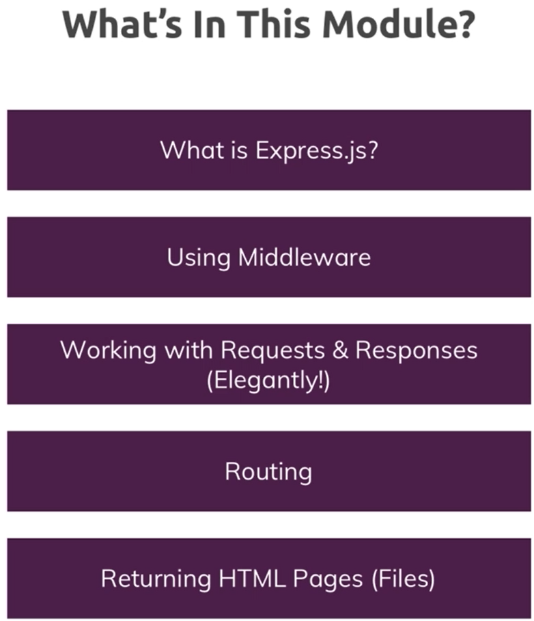
Module 3 - Express.js
Do not re-invent the wheel

Slide 22
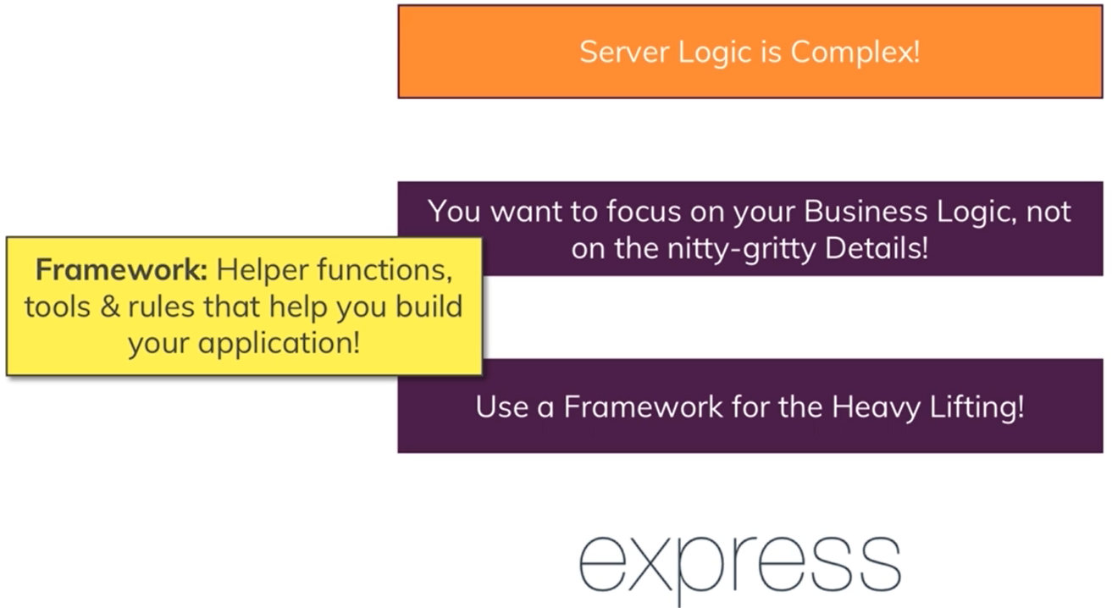
What is Express.js and Why do we need it

Slide 23
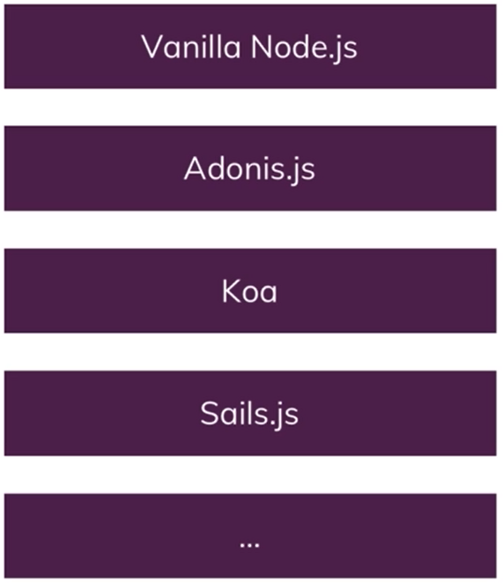
Alternatives of Express.js

Slide 24
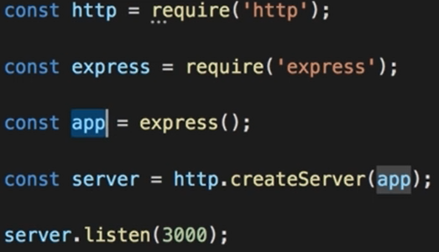
Installing Express.js
User “npm install –save express”

Slide 25
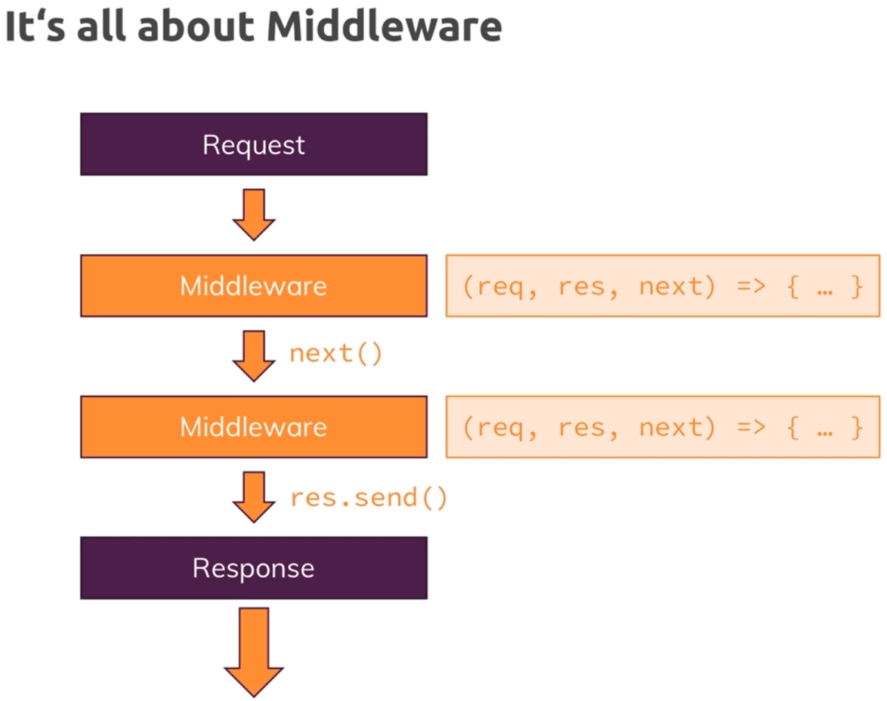
Adding Middlewares

Slide 26
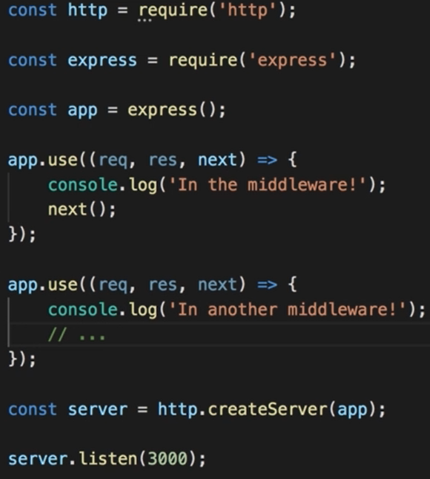
Adding Middlewares (Cont.)

Slide 27
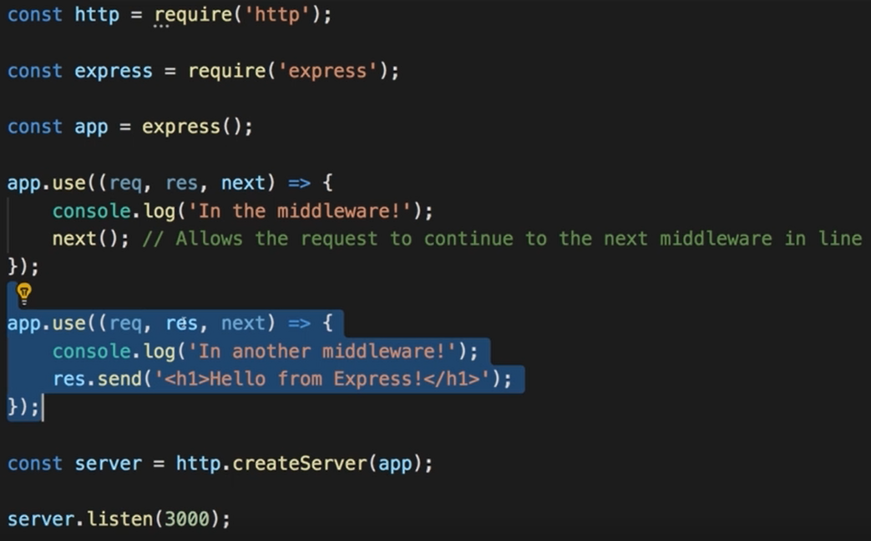
How middleware works

Slide 28
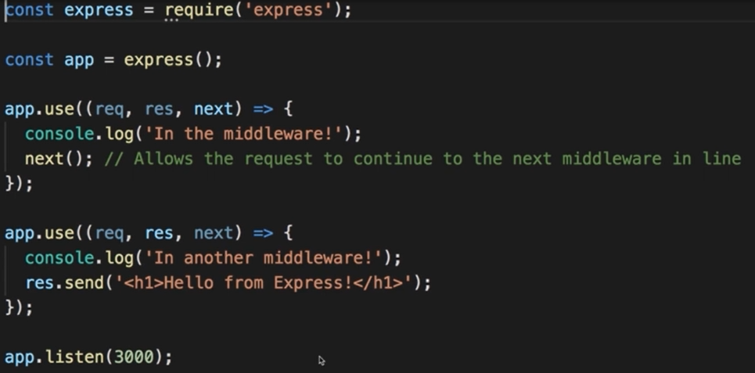
Express.js Look Behind the scene

Slide 29
Handling Different Routes

Slide 30
Parsing Incoming Requests & Limiting Middlwares to POST request

Slide 31
Using Express Router

Slide 32
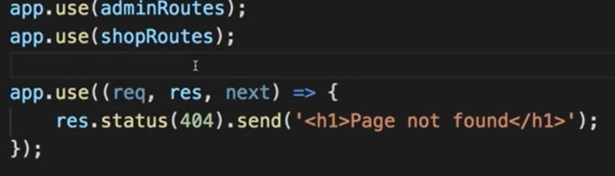
Adding a 404 Error Page

Slide 33
Filtering Paths

Slide 34
Creating HTML Pages

Slide 35
Serving the HTML Files

Slide 36
Returning a 404 HTML Page

Slide 37
Styling our page
You have already done it in bootcamp foundation

Slide 38
Serving files statically

